Slide 1


Online Fraud Detection Project
Presented by / Eng Abdullah Nabil

Slide 2
Introduction
Objective: Develop a machine learning model for detecting fraudulent transactions.
Importance: Fraud detection enhances financial security and prevents financial losses.
Project Steps:
Data loading
Data exploration
Data cleaning
Data analysis
Feature engineering
Model training
Model evaluation

Slide 3
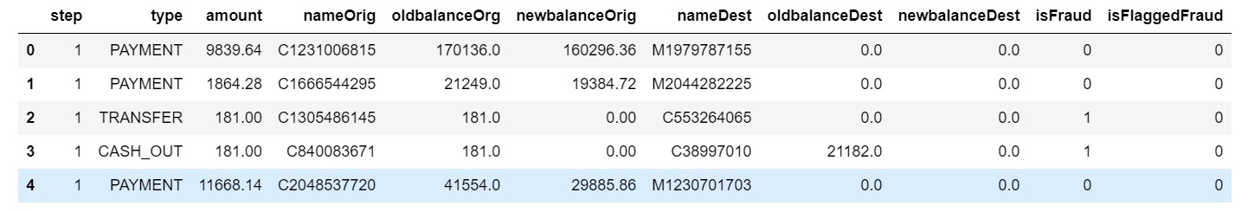
1. Data Loading

Slide 4
2. Data Exploration
We begin by exploring the dataset to understand its structure. This includes:
Viewing the first few rows of the dataset to inspect the initial sample.
Summarizing the dataset to get an overview of data types, missing values, and basic statistics.
Checking the size of the dataset to know the number of rows and columns.

Slide 5
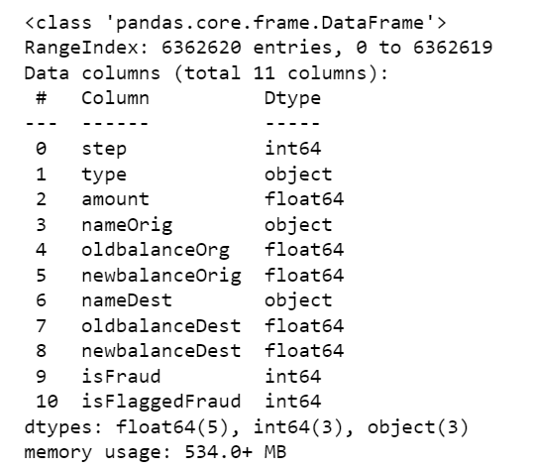
2. Data Exploration

Slide 6
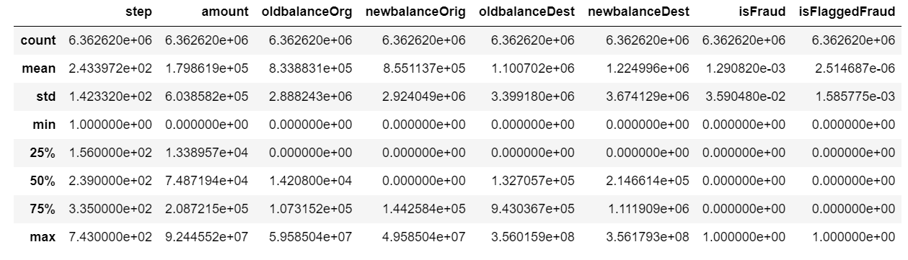
2. Data Exploration

Slide 7
3. Data Cleaning
Data cleaning is a crucial step to prepare the data for analysis. This process includes:
Handling missing values: Missing values can be addressed through various methods such as filling them with mean, median, or mode values, or using more sophisticated imputation techniques.
Removing duplicate records: Duplicate records can skew the analysis and model performance, so they must be removed.

Slide 8
4. Data Analysis
This step involves deeper analysis to understand the relationships between variables:
Calculating the correlation matrix between different features.
Analyzing categorical and numerical variables separately to understand their distributions and relationships.

Slide 9
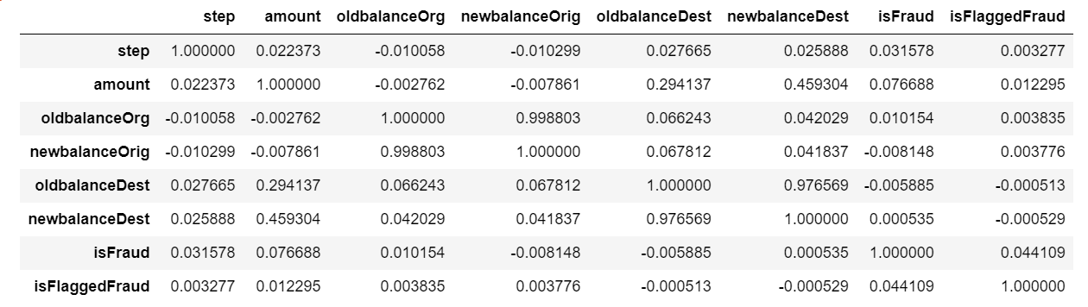
4. Data Analysis

Slide 10
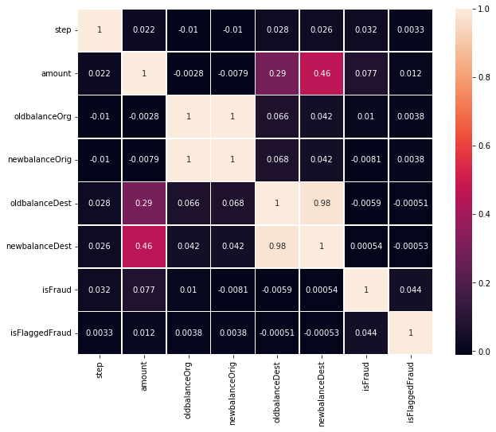
4. Data Analysis

Slide 11
5. Data Visualization
Visualizing the data helps in understanding the distribution and patterns within the dataset. Key visualizations include:
Count plots for categorical variables.
Bar plots to compare means across different categories.
Distribution plots to understand the spread of numerical variables.

Slide 12
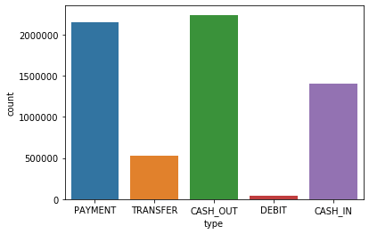
5. Data Visualization

Slide 13
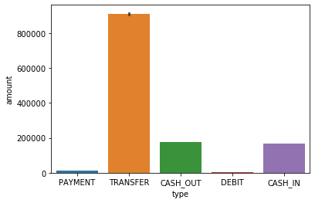
5. Data Visualization

Slide 14
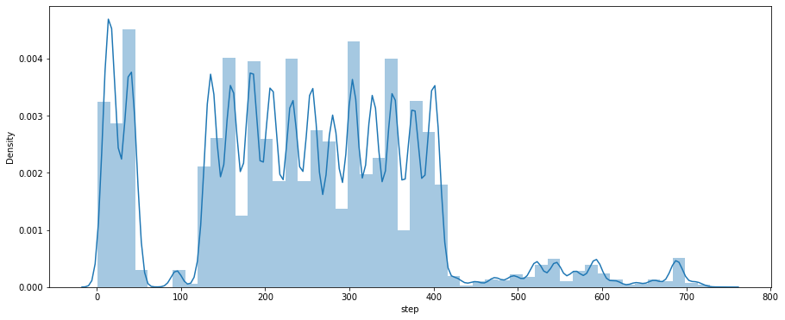
5. Data Visualization

Slide 15
6. Outlier Detection
Outliers can significantly impact the model's performance. We use statistical methods like the Interquartile Range (IQR) to detect and handle outliers. Outliers can be removed or transformed to minimize their effect on the model

Slide 16
6. Outlier Detection
Numerical outliers detected: amount: 338078
outliers oldbalanceOrg: 1112507
outliers newbalanceOrig: 1053391
outliers oldbalanceDest: 786135
outliers newbalanceDest: 738527
outliers Categorical outliers detected: type: 41432
outliers nameOrig: 6362620 outliers nameDest: 6362620 outliers

Slide 17
7. Feature Engineering
Feature engineering involves transforming and creating new features to improve the model's performance. Key tasks include:
One-hot encoding: Converting categorical variables into numerical format.
Dropping irrelevant features: Removing features that do not contribute to the model’s predictive power.

Slide 18
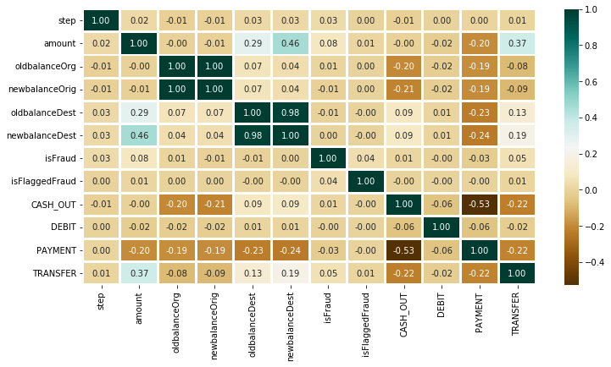
7. Feature Engineering

Slide 19
8. Handling Imbalanced Data
Fraudulent transactions are typically much less frequent than legitimate ones, leading to an imbalanced dataset. To address this imbalance, we use techniques like the Synthetic Minority Over-sampling Technique (SMOTE) to create synthetic samples of the minority class.

Slide 20
8. Handling Imbalanced Data
Original dataset shape:
Counter({0.0: 6354407, 1.0: 8213})
2. Resampled dataset shape:
Counter({0.0: 6354407, 1.0: 6354407})

Slide 21
9. Data Splitting
We split the dataset into training and testing sets to evaluate the model's performance. A common split is 70% for training and 30% for testing. This ensures that the model is trained on a large portion of the data but is also evaluated on unseen data to test its generalization ability.

Slide 22
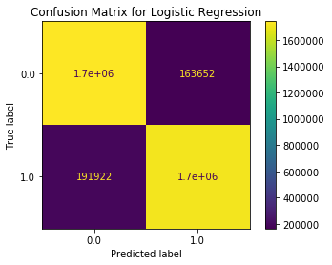
10. Model Training and Evaluation
Training Logistic Regression...
Logistic Regression :
Training Accuracy : 0.9656441971559094
Validation Accuracy : 0.9656740574023731

Slide 23
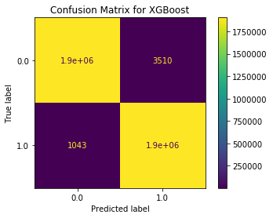
10. Model Training and Evaluation
Training XGBoost...
XGBoost :
Training Accuracy : 0.9999829884753588
Validation Accuracy : 0.9999803496666435

Slide 24
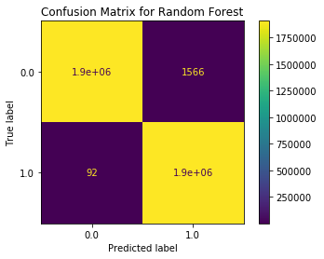
10. Model Training and Evaluation
Training Random Forest...
Random Forest :
Training Accuracy : 0.9999998850068438
Validation Accuracy : 0.9999469018086247

Slide 25
11. Model Selection
Based on the evaluation metrics, we select the best-performing model. This involves comparing the models’ performance on the validation set and choosing the one with the highest accuracy, precision, recall, and AUC-ROC score.

Slide 26
12. Model Deployment
The selected model is saved and prepared for deployment. Deployment involves integrating the model into a real-time system that can process incoming transactions and flag suspicious activities. This includes setting up a pipeline that receives transaction data, applies the model, and outputs fraud predictions.

Slide 27
Conclusion
In conclusion, this project demonstrates the process of developing a machine learning model for fraud detection. The steps include data loading, exploration, cleaning, analysis, feature engineering, handling imbalanced data, model training, evaluation, and deployment. Each step is critical to ensure the accuracy and reliability of the final model. The deployed model can help financial institutions detect fraudulent transactions in real-time, thereby reducing financial losses and protecting customers.

Slide 28
THANK YOU

